Slide 1
Uniform Circular Motion

Slide 2
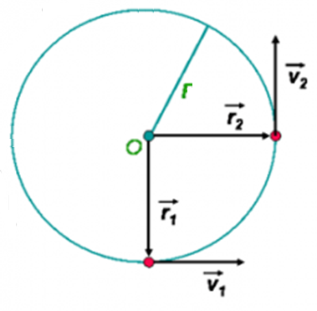
Uniform Circular Motion
The movement of an object is at a constant speed with a fixed radius.
Thus v = ∆r/ ∆t
The object accelerates due to the direction constantly changing.
Thus a= ∆v / ∆t

Slide 3
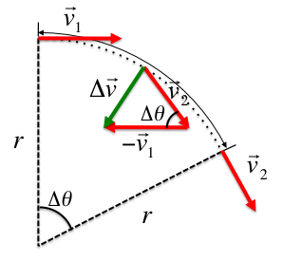
Uniform Circular Motion
Compare the triangle made from the position vectors to the ones made by the velocity vectors (same )
They are similar triangles.
Therefore:
∆r = ∆v
r∆t v∆t

Slide 4
Uniform Circular Motion
∆r = ∆v
r∆t v∆t
Remember that v = ∆r/ ∆t
So substitution gets us
v = ∆v
r v∆t

Slide 5
Uniform Circular Motion
v = ∆v
r v∆t
Remember that a = ∆v/ ∆t
So substitution gets us
v = a
r v

Slide 6
Uniform Circular Motion
v = a
r v
Rearranged we get
a= v²
r
This is the centripetal acceleration and always points to the center of the circle

Slide 7
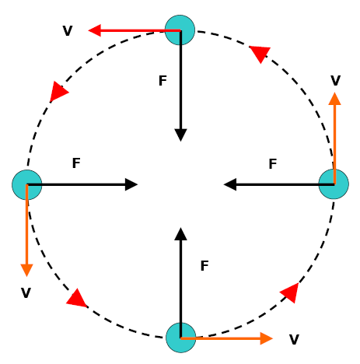
Uniform Circular Motion
Using Newton’s Second Law:
F=ma
The centripetal force can be found.
m= mass of object
a= centripetal acceleration
This force is the tension on the string in demonstration.

Slide 8
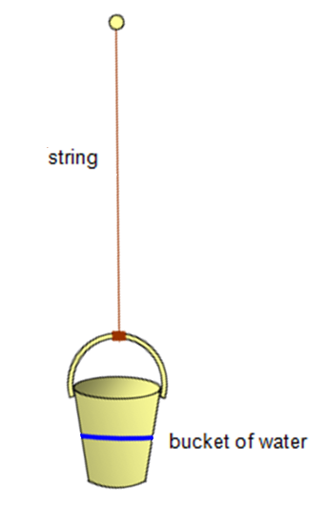
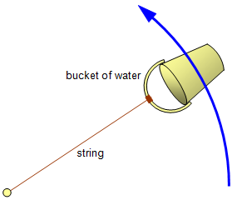
Uniform Circular Motion
In which direction is the force of tension?
In which direction is gravity perceived to be?

Slide 9
Uniform Circular Motion
Period (T) is the amount of time it takes to make one revolution.
Distance is the circumference (C)= $2πr$
So velocity is v= d or $2πr$
t T
Acceleration then is a= v² or (2$πr$/T) ²
r r
Simplified becomes a= 4$π\text{2}r$/T²

